Slide 1
AI Studdy Buddy
User Evaluation
Anika Mayesha – D24125187
Lorenzo Palleschi – D24126922
Rumaysa Babulkhair – D24125711
Yurii Sykal – C23512523

Slide 2
Agenda
UX Framework
Discover Phase
Explore Phase
Test Phase
Listen Phase
Summary & Next Steps

Slide 3
The 4 Phases of UX
Discover
Discover: Understand user needs
Explore: Personas, wireframes, design
Test: Evaluation, SUS, walkthrough
Listen: Improvements, roadmap
Explore
Test
Listen

Slide 4
1.
Discover

Slide 5
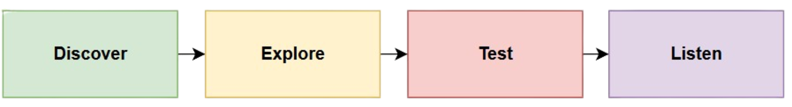
Phase 1 - Discover
Problem Definition
Students struggle with:
Inconsistent study habits
Poor organisation
Difficulty summarizing content
Exam stress and inefficient revision
AI Study Buddy:
Supports summarization, flashcards, self-regulation, and focus.

Slide 6
Functional Requirements
Non-Functional Requirements
Upload PDFs / images / text
AI Summaries
Flashcard generation
AI Chat Assistant
Focus Timer
Dashboard
Login / Registration
High usability & learnability
Accessibility (WCAG 2.1)
Reliability & stability
Performance: fast responses
Visual consistency
Secure data handling

Slide 7
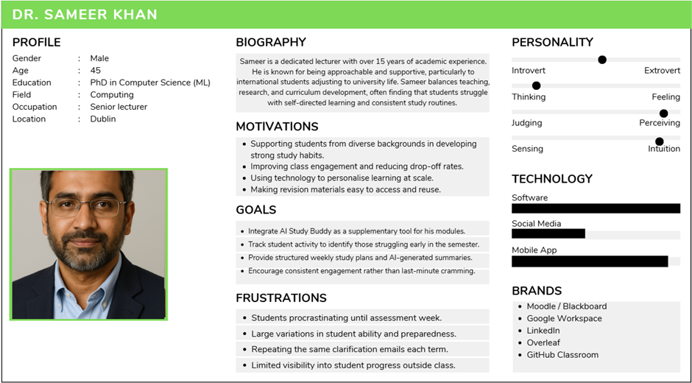

ROLE OF PERSONAS
Feature selection (flashcards, summaries, timer)
Interface simplicity
Selection of test participants
Future expansion (professor-led features)

Slide 8
2.
Explore

Slide 9
Phase 2 - Explore
USER STORIES: EXAMPLEs
“As a student, I want to upload notes so I can get summaries.”
“As a student, I want to utilise flashcards to revise efficiently.”
“As a student, I want a timer so I can focus during study sessions.”

Slide 10
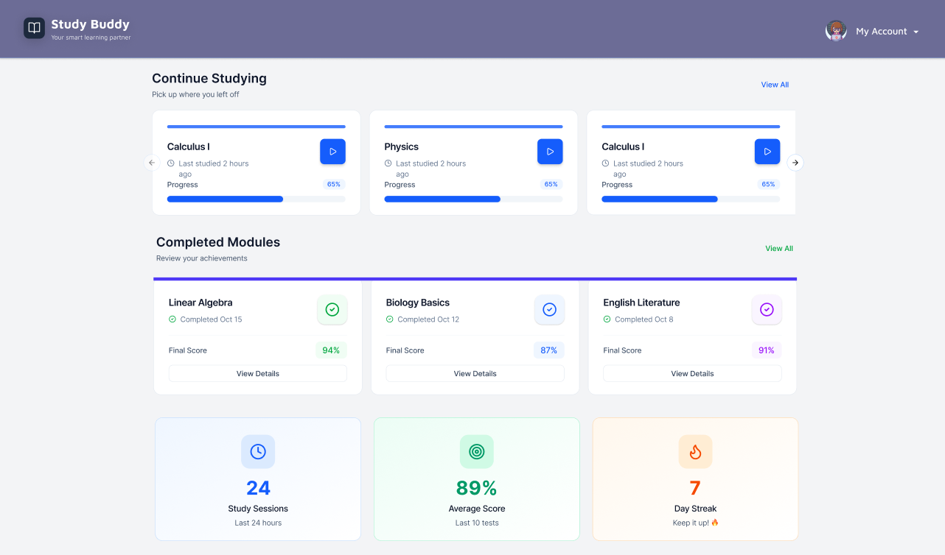
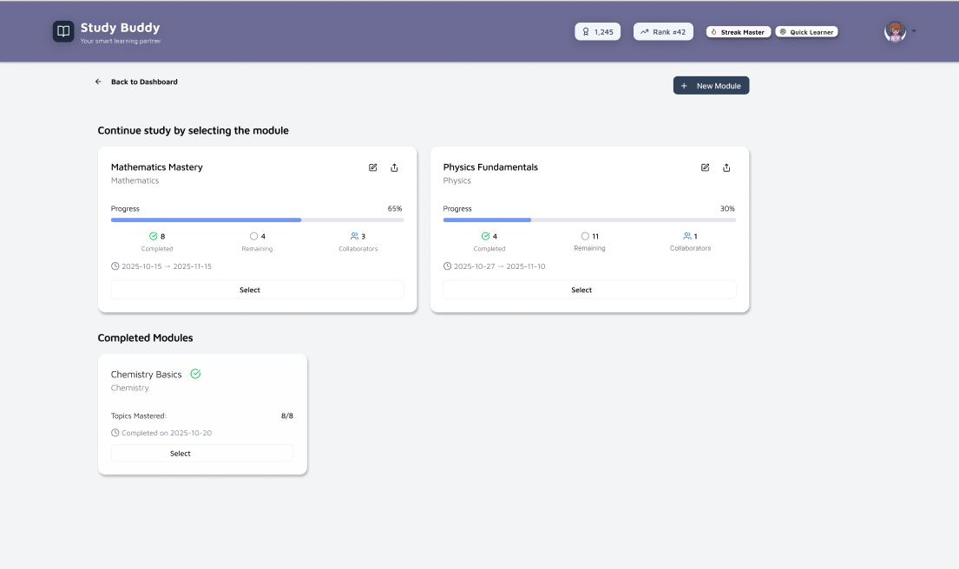
FIGMA → APPLICATION EVOLUTION (Module Selection)
Notes:
Showing improvements after expert review:
Larger icons
Better spacing
Improved colour contrast
Clearer dashboard text

Slide 11
3.
Test

Slide 12
Phase 3 - Test
Methodology Overview
Mixed-methods usability evaluation combining quantitative and qualitative approaches

Slide 13
Phase 3 - Test
Methodology Overview
Expert Review
System Usability Scale (SUS)
Think-Aloud (written)
Observational Walkthrough
Accessibility Checks
Open-Ended Questionnaire

Slide 14
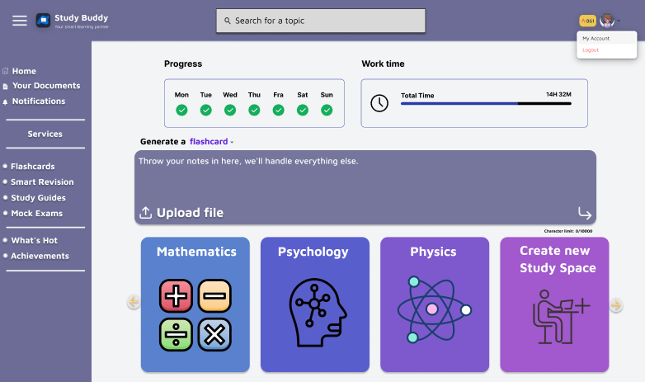
Phase 3 - Test
EXPERT REVIEW (ANDREA)
Feedback:
Various pages & Figma designs
Highlighted design choices
Gave advice on features from our various designs
- Dev focus on features, but feedback will be implemented later
Notes:
Went through various pages & figma designs to determine which features we should take (search bar)

Slide 15
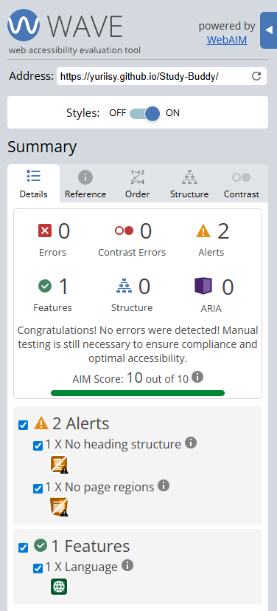
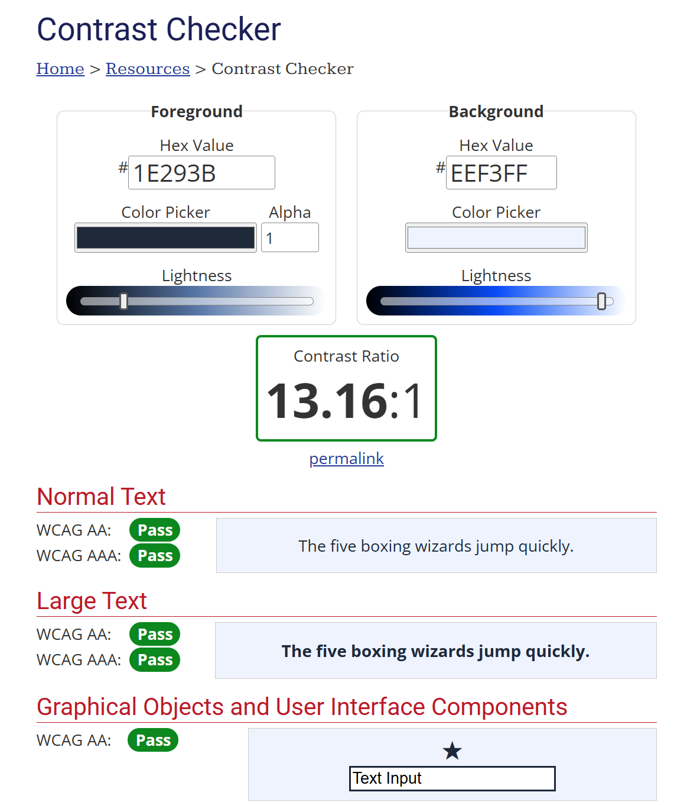
Phase 3 - Test
Accessibility Checks
Tools used:
WAVE WebAIM
W3C Colour Contrast Checker
IBM Equal Access Checker (Planned)
Notes:
Fine comparing the background as the background of the centre, but terrible when checked against white background.

Slide 16
Phase 3 - Test
Evaluation Setup
19 participants (observational)
11 completed full questionnaire
Walkthrough due to university firewall issue

Slide 17
Evaluation Setup
Methods used:
- SUS (System Usability Scale)
- Qualitative open-ended questions
- Think-aloud (written)
- Observational task clarity
- Accessibility checks
- Expert review

Slide 18
Ethical Considerations
Fully voluntary
Anonymous responses
No personal data collected
Secure storage
Low-risk classroom setting
Aligned with research integrity standards

Slide 19
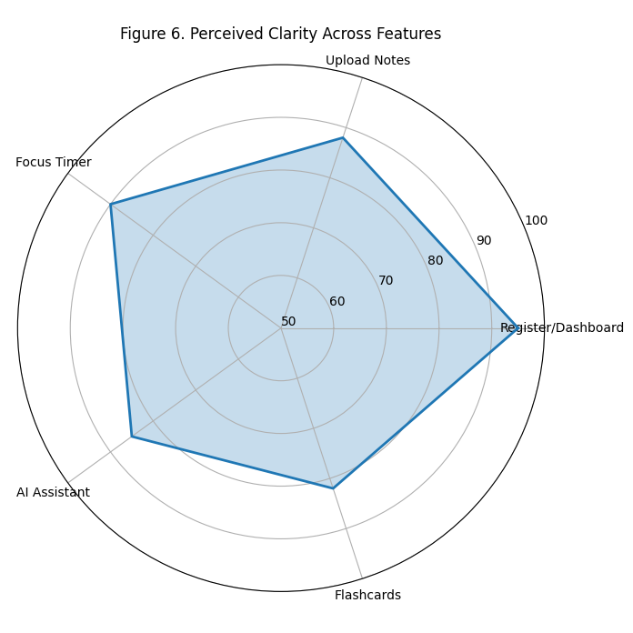
OBSERVATIONAL FINDINGS
Clarity ratings:
Dashboard: 95%
Upload Notes: 88%
Focus Timer: 90%
AI Assistant: 85%
Flashcards: 82%

Slide 20
QUALITATIVE THEMES
Most useful:
Flashcards
Timer
AI summaries
Missing features:
Export notes / flashcards
Dark mode
Repetition for incorrect answers
Minor issues:
Timer unclear
Dashboard needs descriptions

Slide 21
Solo Taxonomy
SOLO Level | Count | Example
Uni-Structural | 2 | “Flashcards were useful”
Multi-Structural | 5 | Several missing features or reasons for usefulness
Relational | 3 | Connects the features to studying habits
Extended Abstract | 1 | Suggested structural improvements which were tied to learning outcomes (e.g., blueprint roadmap)
82% = Multi-structural or higher
Notes:
Important for cognitive depth

Slide 22
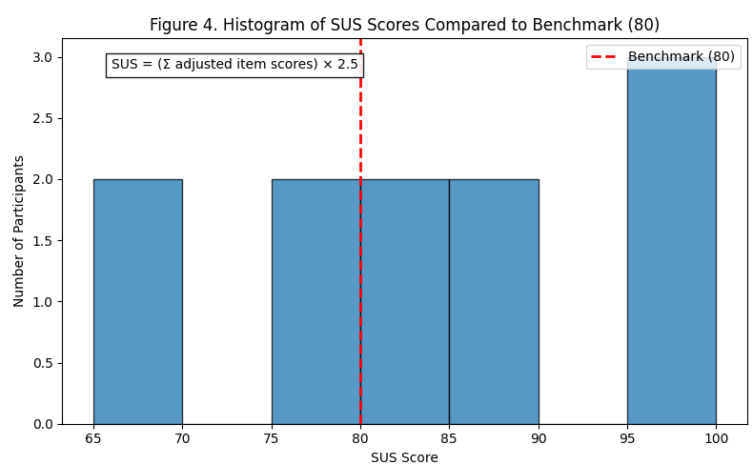
System Usability Scale (SUS)
Benchmark of 80
Score: 84.1 (“Excellent”)
Notes:
Benchmark achieved

Slide 23
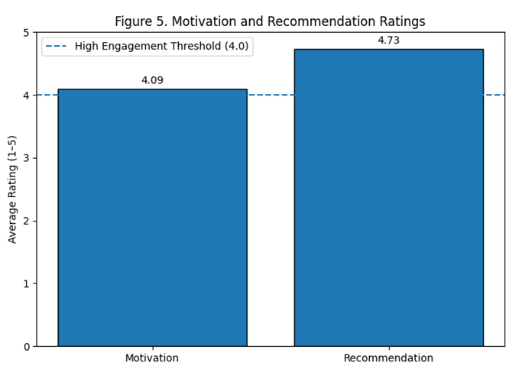
System Usability Scale (SUS)
- Motivation: 4.09 / 5
- Recommendation: 4.73 / 5
Notes:
Strong indication of user usefulness & adoption likelihood.

Slide 24
4.
Listen

Slide 25
Phase 4 - Listen
Key Changes to Implement
New dashboard onboarding text
Larger, clearer icons
Add timer settings button
Add search bar
Improve colour contrast
Clearer upload instructions

Slide 26
Feature Roadmap
Exportable summaries & flashcards
Dark mode
Spaced repetition learning
Re-ask incorrect flashcards
Professor view

Slide 27
TECHNICAL IMPROVEMENTS
Host on cloud (no firewall issues)
Faster PDF parsing
Cache AI outputs
UI rendering optimised
Better error handling

Slide 28
FUTURE TESTING
Full interactive test (not walkthrough)
Task completion timing
Error rate tracking
Larger sample
Longitudinal study
Formal accessibility evaluation

Slide 29
CONCLUSIONS
Recognition of the benefit of our project
High usability (SUS 84.1)
Strong user motivation
Walkthrough limitations noted
Clear roadmap for improvements
Full testing cycle prepared for next phase

Slide 30
THANK YOU
Questions?

